Slide 1

SAFE SCREEN
BY:
HARINI K
HARINI K M
Panimalar engineering college.

Slide 2

ABSTRACT
Youth Guard is an innovative default option in settings that focuses on promoting responsible and safe mobile devices usage for young users aged 10-18. Youth Guard stands as a pioneering initiative aimed at promoting digital wellness and safety among young users. By integrating age-appropriate access, parental monitoring, and screen time management features. It incorporates various features and ensure age-appropriate access, parental monitoring, and a healthy balance in screen time.

Slide 3
Problem in Society
Affects brain processing: The human brain is sensitive to electromagnetic radiation, and mobile phones, which primarily use electromagnetic waves, can disrupt brain processing for up to an hour. These radiations can disrupt the neural network, slowing down brain processing.
Academic performance: Mobile phones significantly impact children's academic performance, leading to decreased concentration, time spent on studies, and awareness issues. Research indicates that excessive use can negatively affect children's academic grades, attention, and overall focus on their studies.
Sleeping habits: Mobile phone alarms can transmit harmful microwave radiation, especially to children's brains. It's important not to let children sleep with phones in their hands, as this can disrupt their sleeping habits and lead to mental health issues.

Slide 4
Proposed Solution
Digital Literacy and Online Safety Education: Educate young individuals about responsible mobile device usage, online safety, privacy settings, and the potential risks associated with sharing personal information online. This empowers them to make informed decisions and navigate the digital world safely.
Encourage Offline Activities: Encourage young individuals to engage in a variety of offline activities such as physical exercise, hobbies, reading, or socializing with friends and family. Promote a healthy balance between online and offline experiences.
Cyberbullying Awareness and Intervention: Educate young individuals about cyberbullying, its effects, and how to respond. Encourage reporting and provide support systems to intervene in cases of cyberbullying or online harassment.

Slide 5
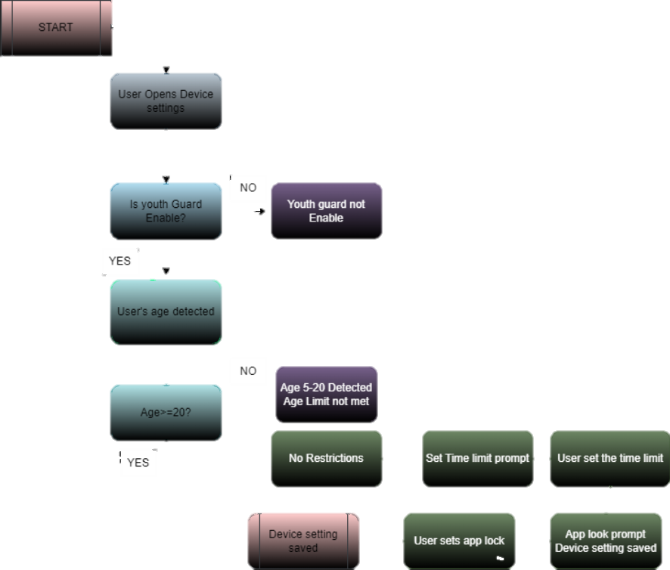
Flow Chart

Slide 6
Uniqueness
Time Limit and Device Auto-Lock: This includes a default time limit for mobile usage, such as half an hour, after which the device automatically locks. This feature encourages young users to take regular breaks from screen time and engage in other activities.
Facial Age Recognition: This default option utilizes the front camera to scan the user's face and determine their age. If the user falls within the designated age range of 10-18, certain apps like Instagram or other social media platforms will be temporarily locked to limit exposure to potentially inappropriate content.
Emergency Call Access: In case of emergencies, the app allows access to emergency calling features, ensuring that young users can contact necessary services or trusted individuals when needed.
And these can be implied though coding

Slide 7
Utility
Enhanced Safety
Responsible Mobile Usage
Parental Peace of Mind
Digital Literacy and Education
Customization and Adaptability
User-Friendly Interface
Collaboration and Communication
Long-term Impact on Well-being

Slide 8
Scalability
1.User Growth
2.Performance
3.Data Management
4.Hardware and Infrastructure
5.System Architecture

Slide 9
Economic Sustainability
Monetization Strategies
Collaborations and Sponsorships
In-App Purchases
Data Analytics and Reporting Services
Grants and Funding
Continuous Value Addition
Global Expansion
Corporate Social Responsibility (CSR)

Slide 10
Environmental Sustainability
Energy-Efficient Development
Server Infrastructure
Minimal Packaging
User Education
Carbon Offset Initiatives
Long-Term Device Usage

Slide 11
Feasibility of the Solution/Innovation
Market Demand
Technical Viability
Regulatory Compliance
Social Impact
User Engagement

Slide 12


